Slide 1
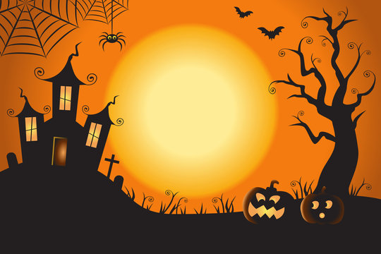
Monster Makey
Kevin Rubio
Jasmine Roach
Sam Downs

Slide 2
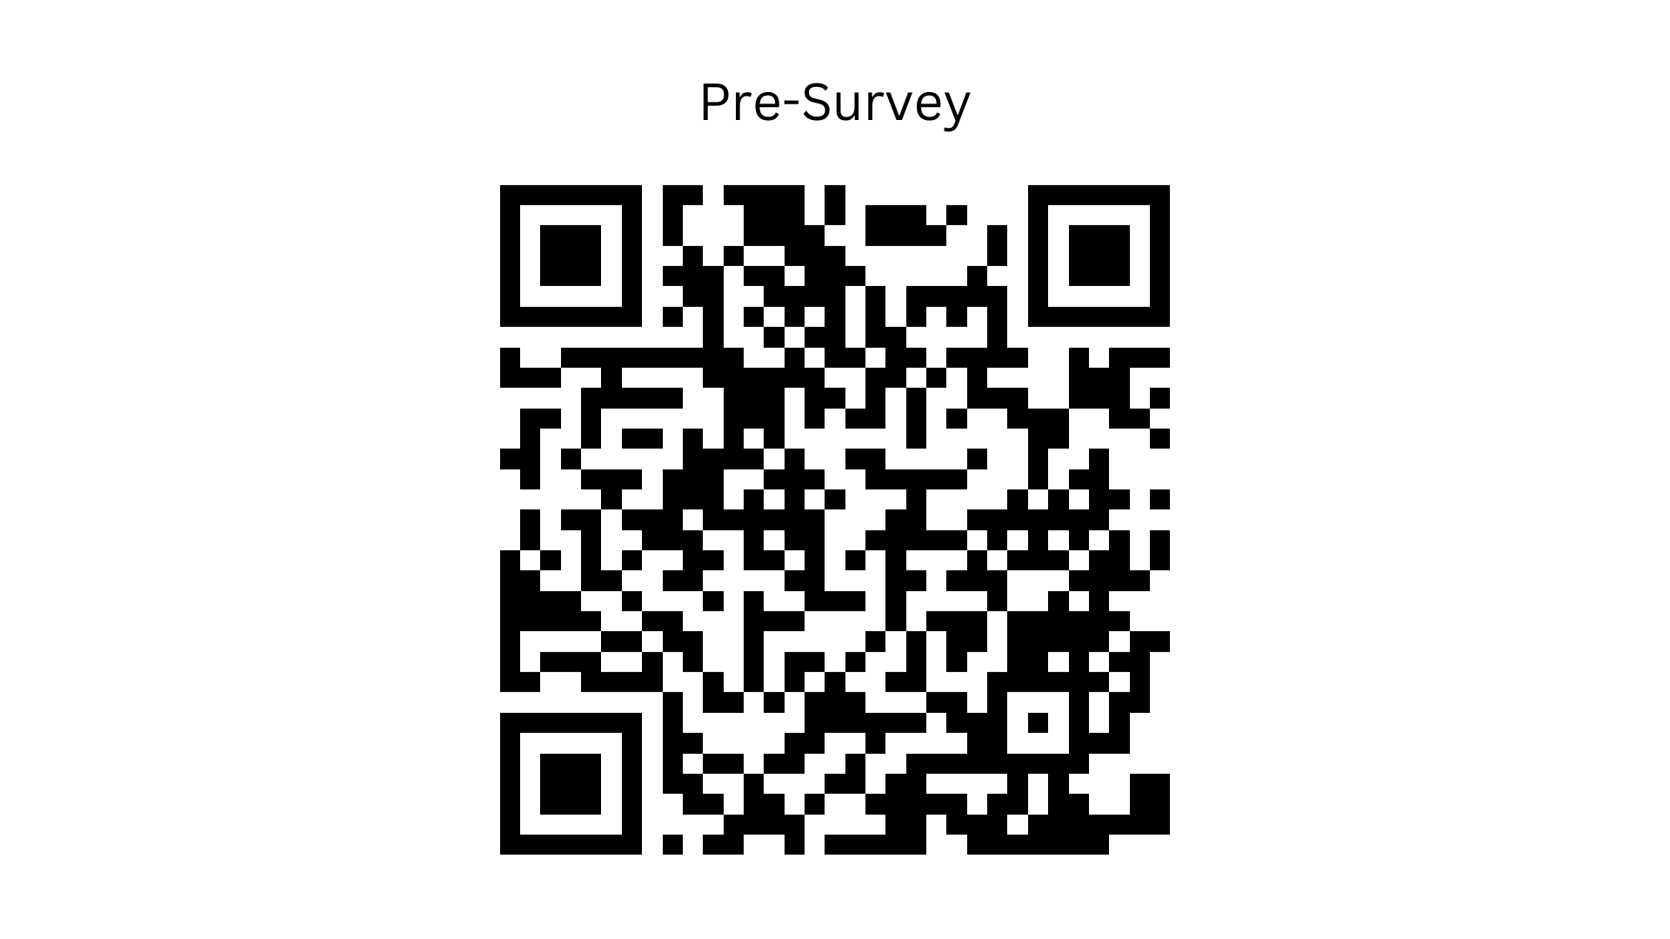

Slide 3

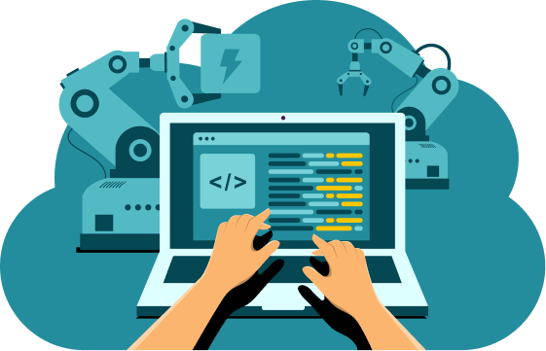
What is TAP?
TAP stands for the Technology Ambassador Program
TAP is a program that helps students develop skills in scholarship, leadership, service and creativity
The goal of this course is to increase an interest in ITEC concentrations
This program creates opportunities for students in introductory STEM courses and GGC outreach initiatives

Slide 4
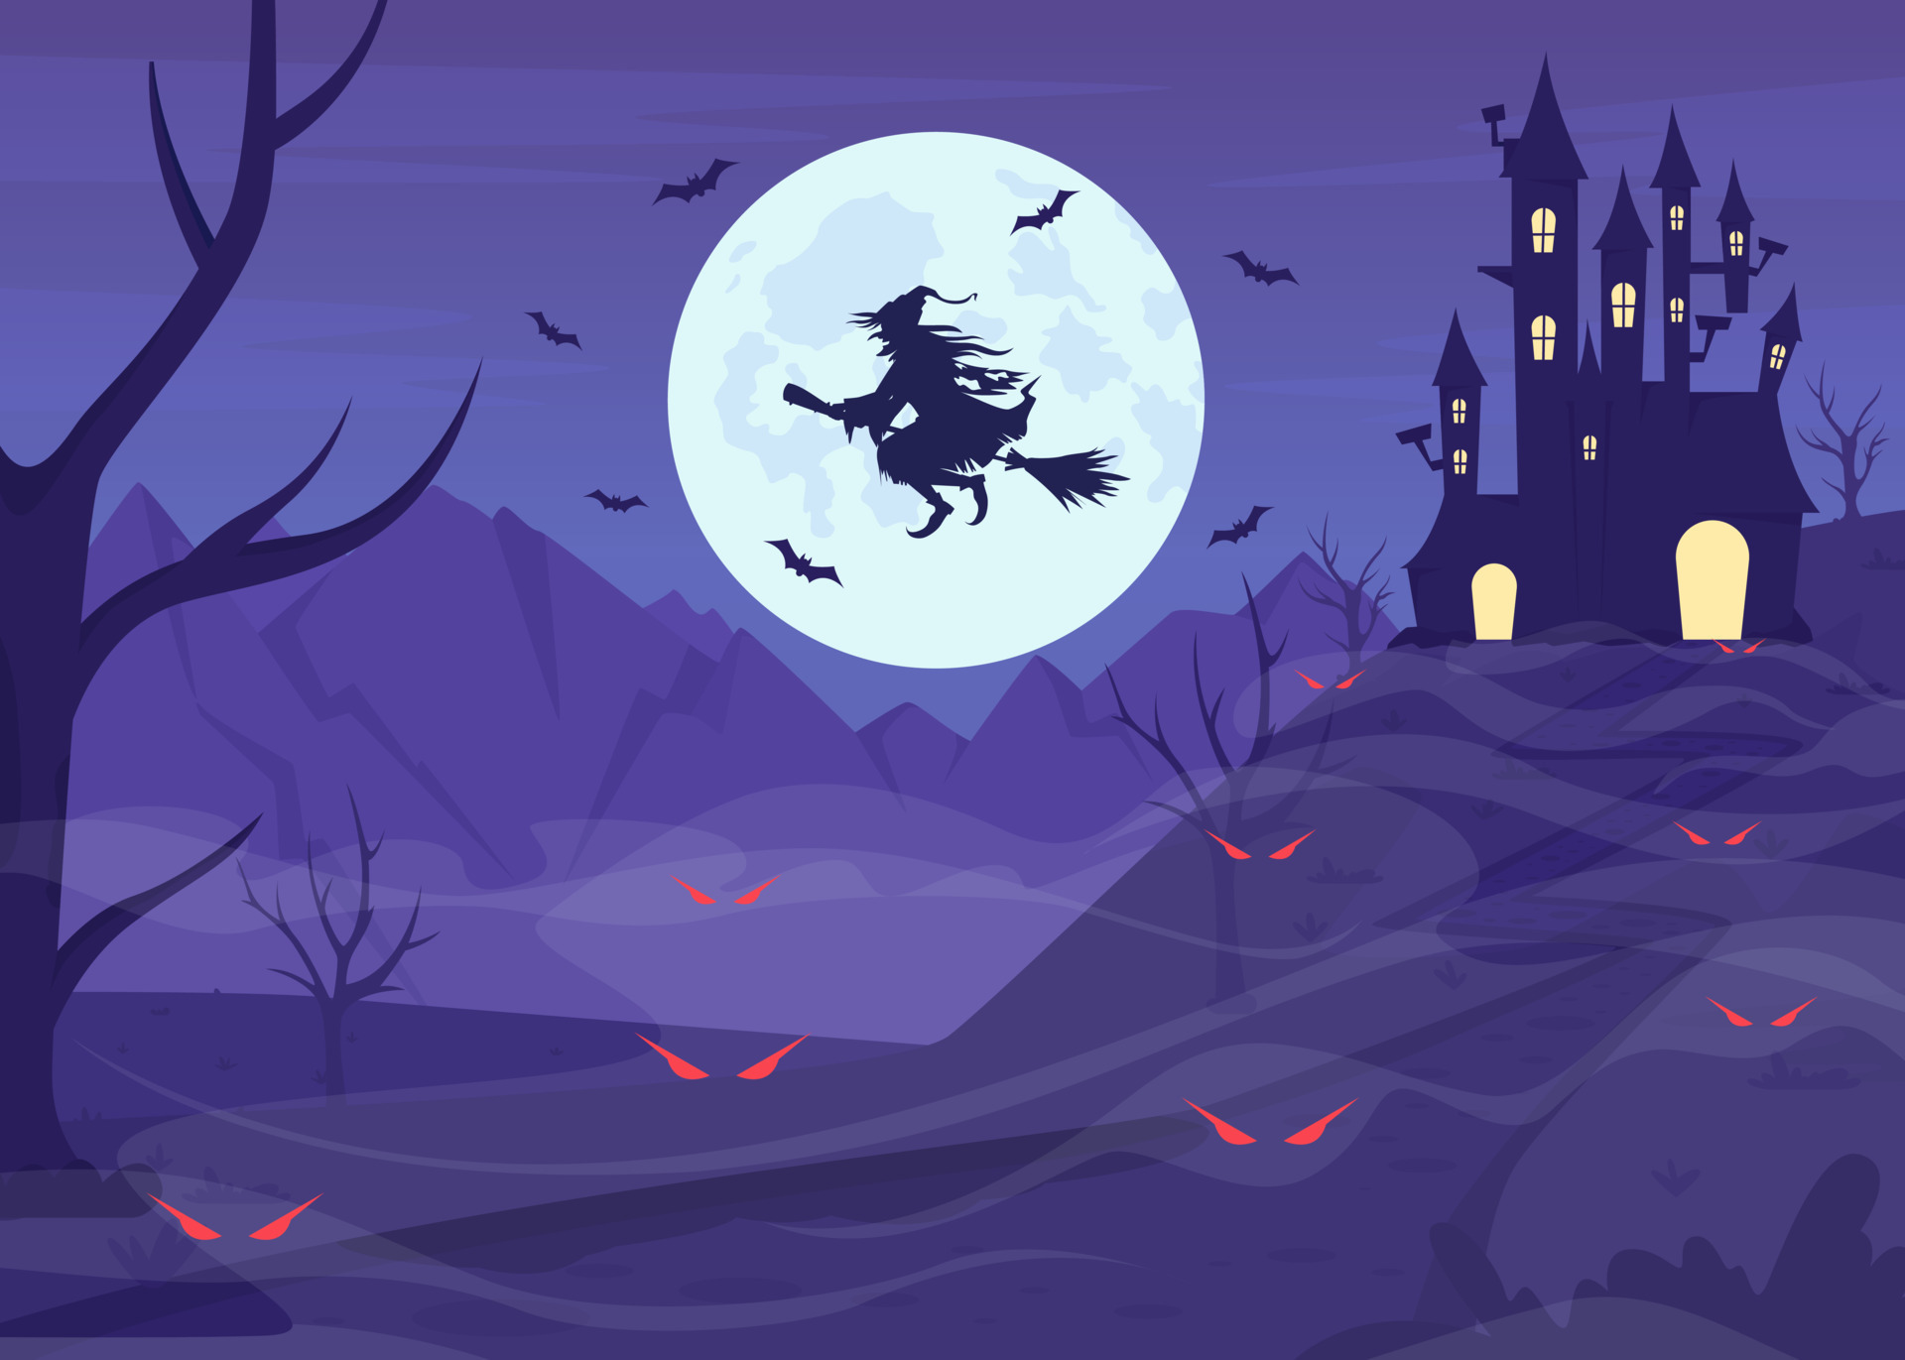

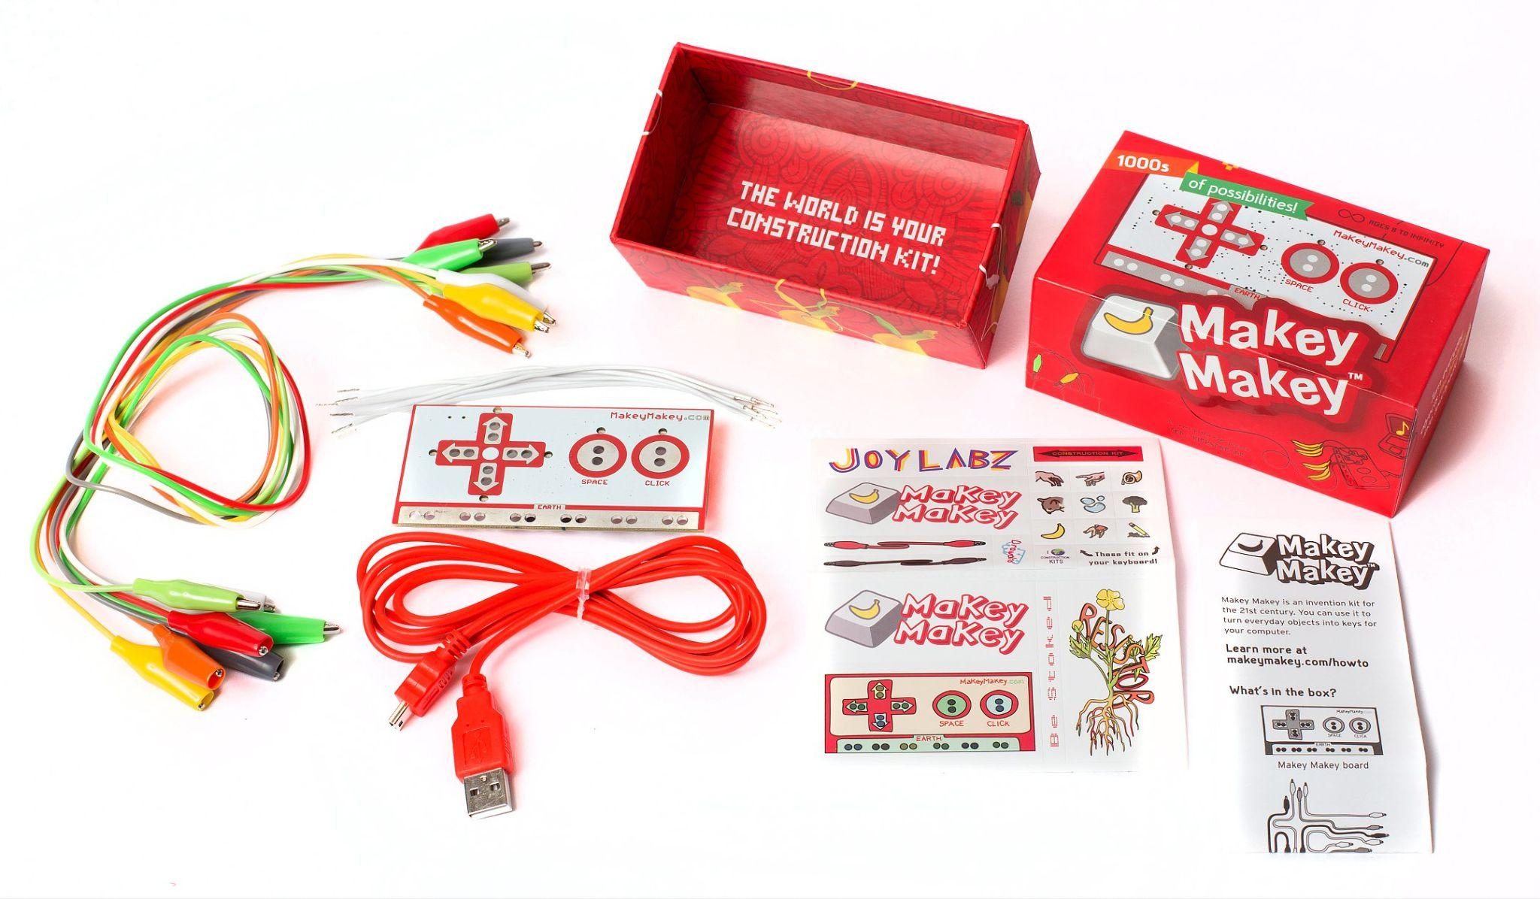
Workshop Description
Students will be walked through how to use a makey makey through scratch
A Makey Makey is an interactive controller designed to connect everyday objects to computer keys
Our goal is to introduce students to sound manipulation through Audacity
Audacity is a free and open-source digital audio editor and recording application software
We wish to teach methods and applications students can use to record, edit, and export sound
Notes:
How does Makey Makey work? Makey Makey work just like a USB keyboard or mouse, sending keyboard (WASD, spacebar, etc) and mouse (left click, right click, etc) signals to your computer. Makey Makey Classic works through opening and closing circuits, just like any other button.

Slide 5
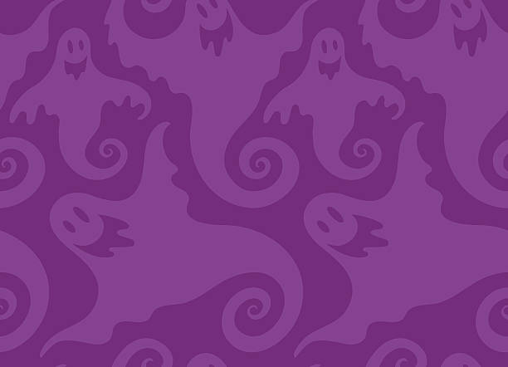
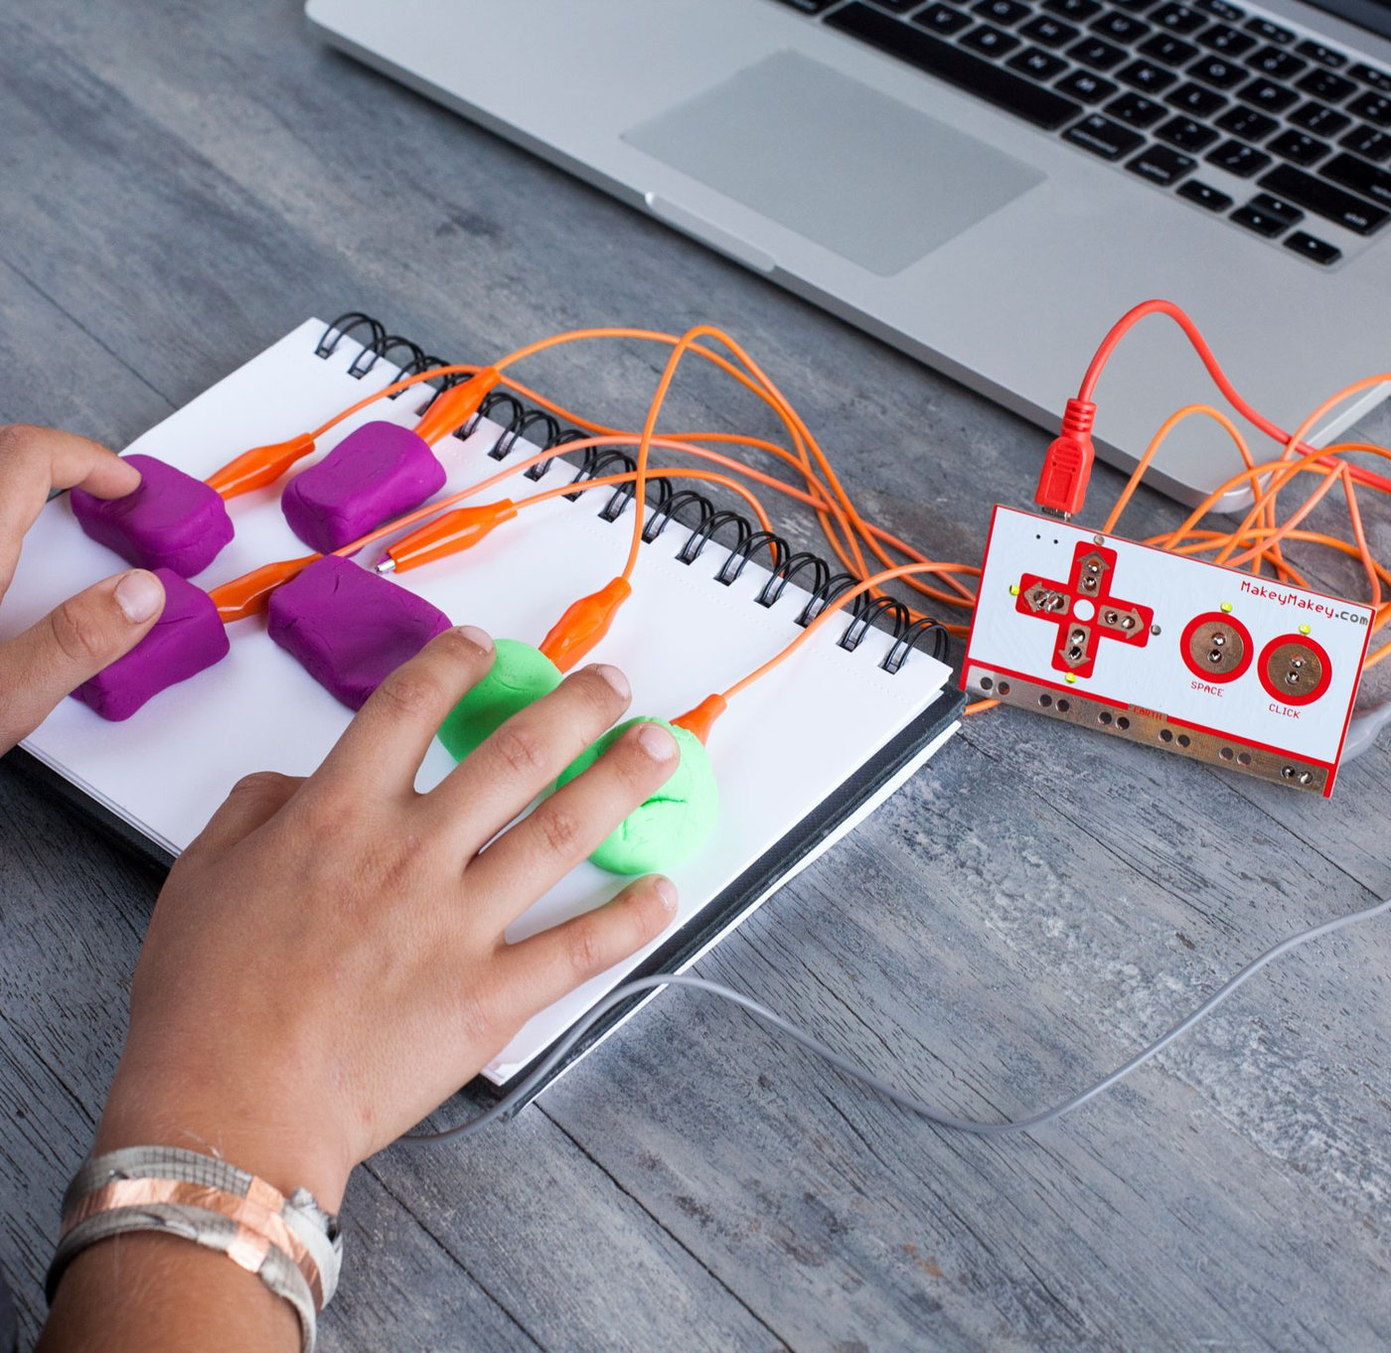
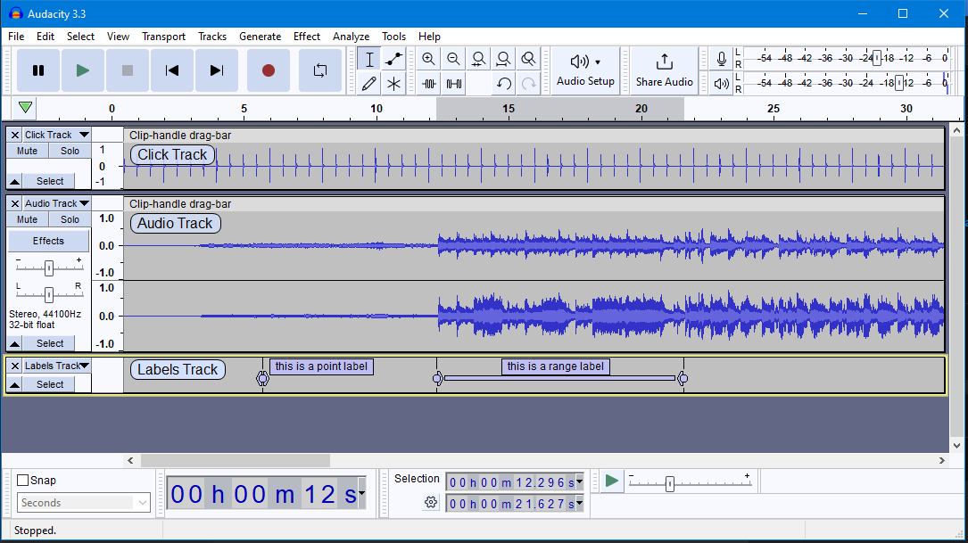
Project Description/Methods
For our project we used tools such as a recording booth with mics and
equipment in order to capture our sound.
Through Audacity were were able to sample and edit the sounds we
captured to our liking.
The students will then be tasked to go into Audacity and manipulate sound clips on their own
After creating their own sounds students will implement those sounds into scratch.
Once they have added their sounds they should be able to
Use the makey makey to play their sound.

Slide 6
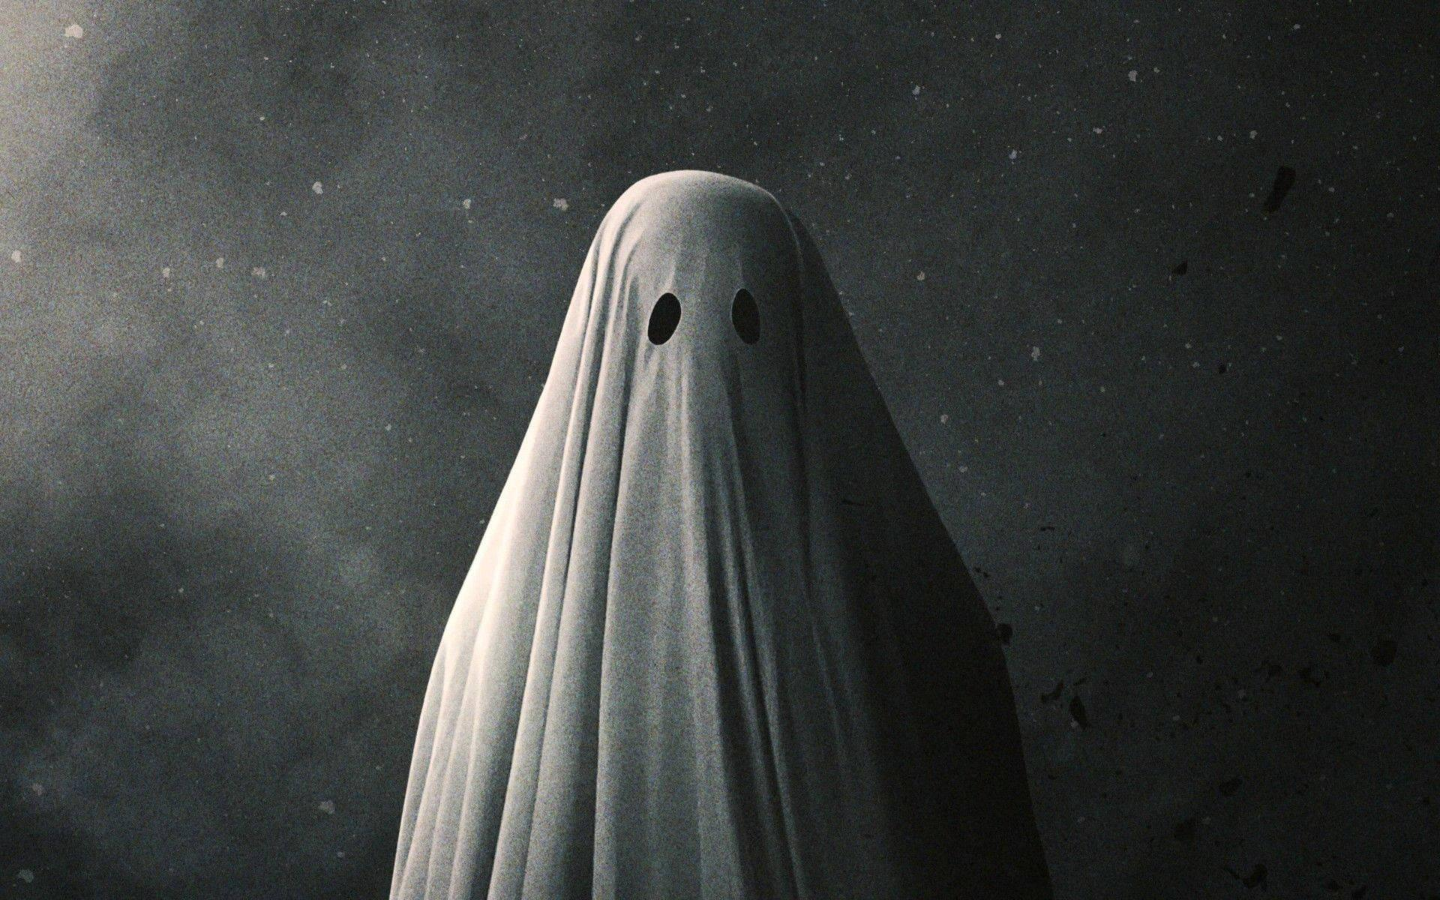
Story Time

Slide 7
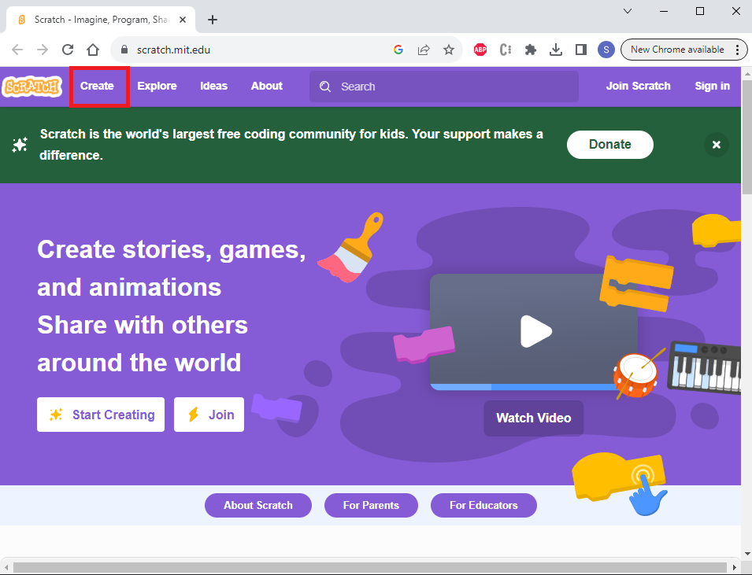
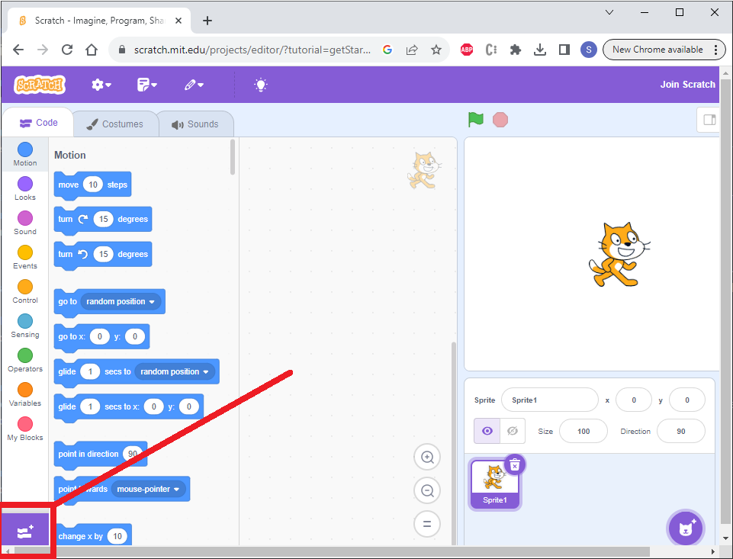
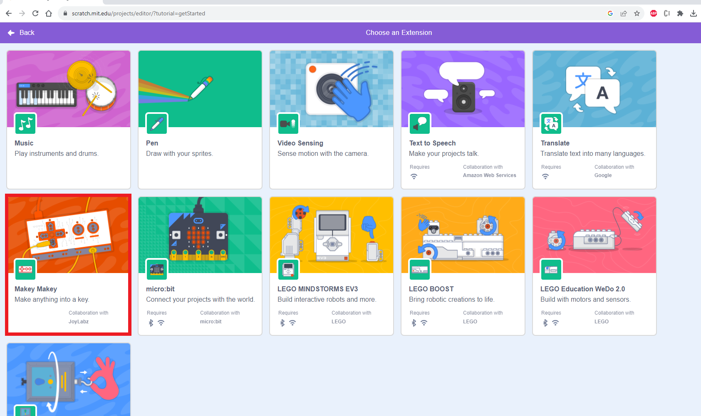
Setting Up the Makey Makey
Head to https://scratch.mit.edu/
Click on the “Create” button on the top left
Click the “Add extension” button on the bottom left

Slide 8
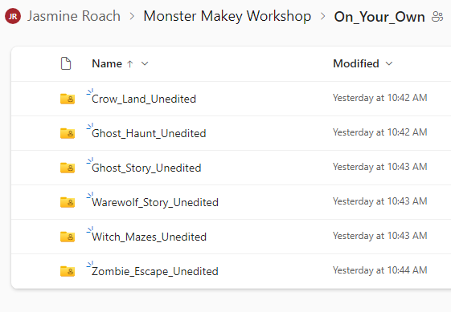
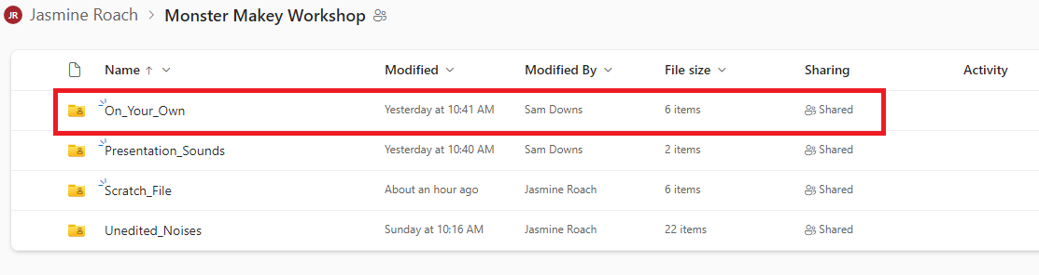
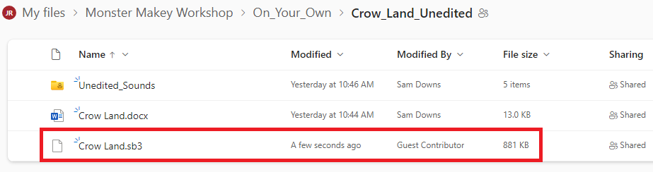
Downloading the Scratch File
In the onedrive, there is a folder named “On_Your_Own”, there are multiple folders that have a unique story

Slide 9
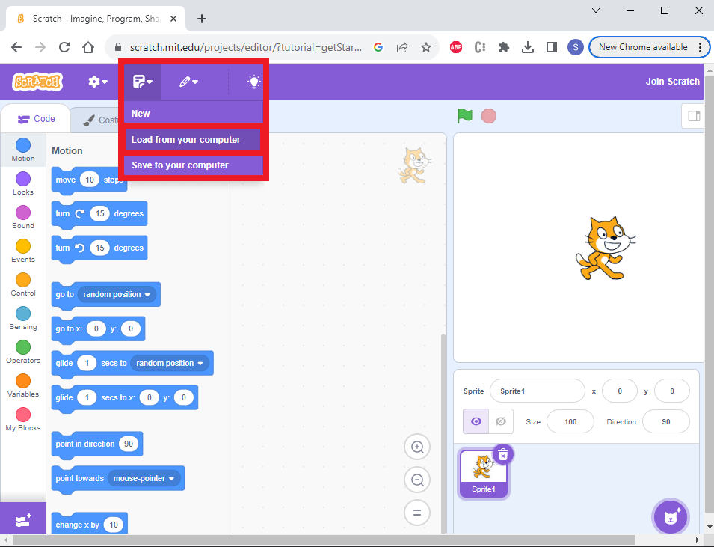
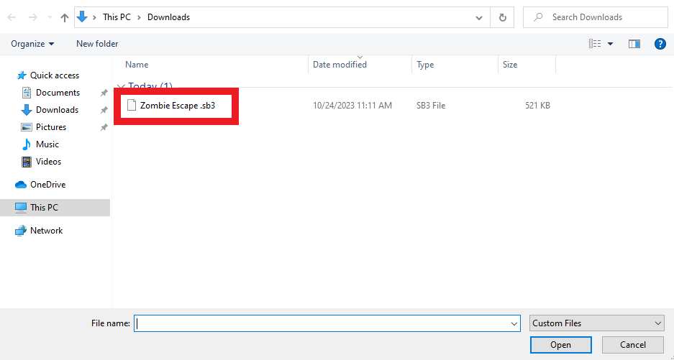
Setting Up the Scratch
Once you load the scratch file from your computer (choose the file ending with .sb3), you will be able to play sounds from the makey makeys
Now play around with makey makeys for a couple of minutes

Slide 10

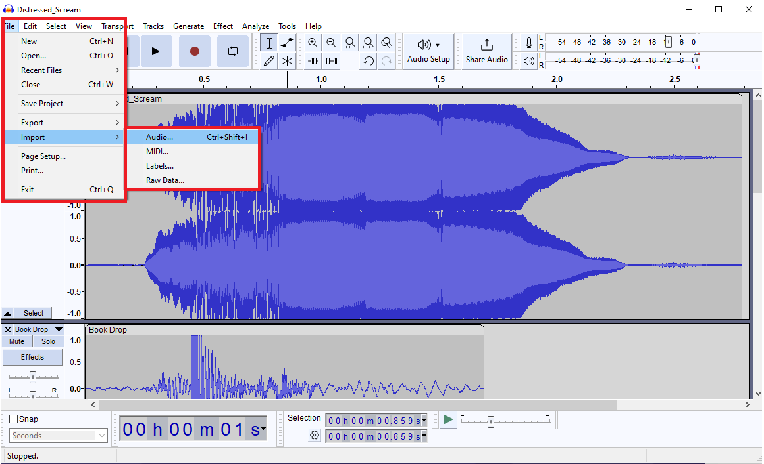
Workshop Description
Open up Audacity
In audacity head to “File”, “Import”, “Audio”, and select all the .mp3 files in the “Presentation_Sounds” folder
Finally you should be able to see multiple tracks with separate “soundwaves” on your screen.

Slide 11
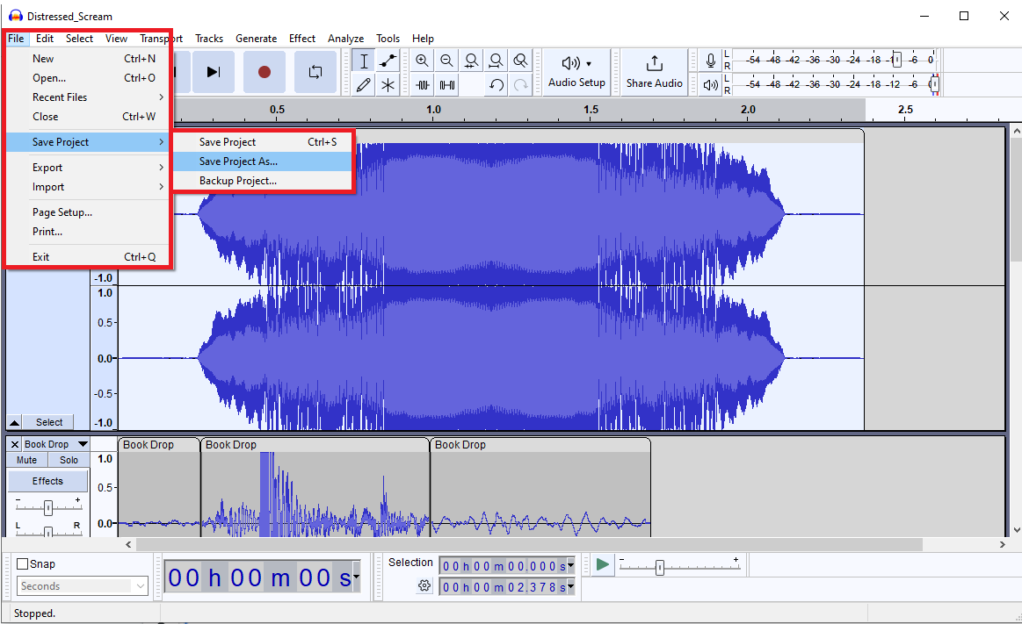
Saving the project
Note that saving the project is not the same as saving the audio files
To save the project, go to file, save project, save project as…

Slide 12
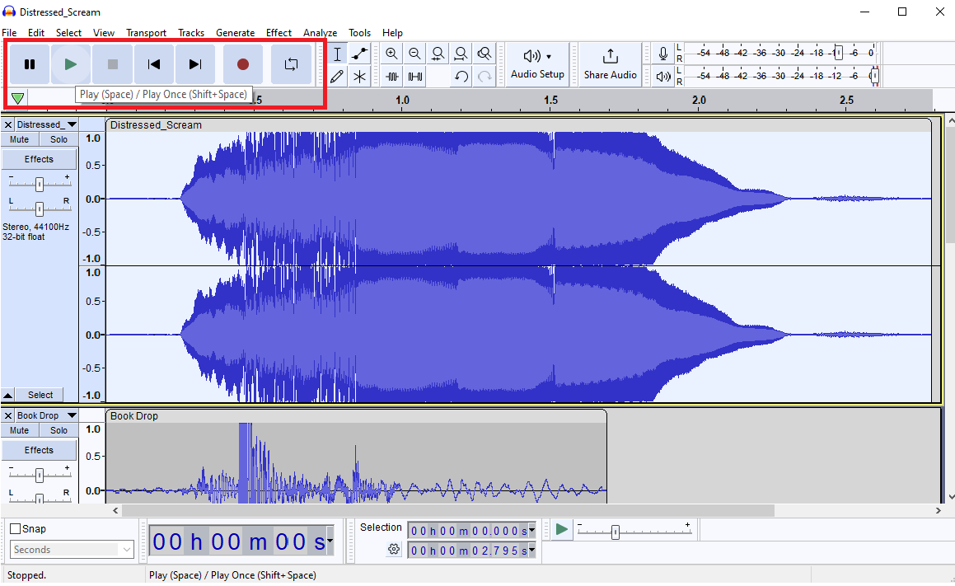
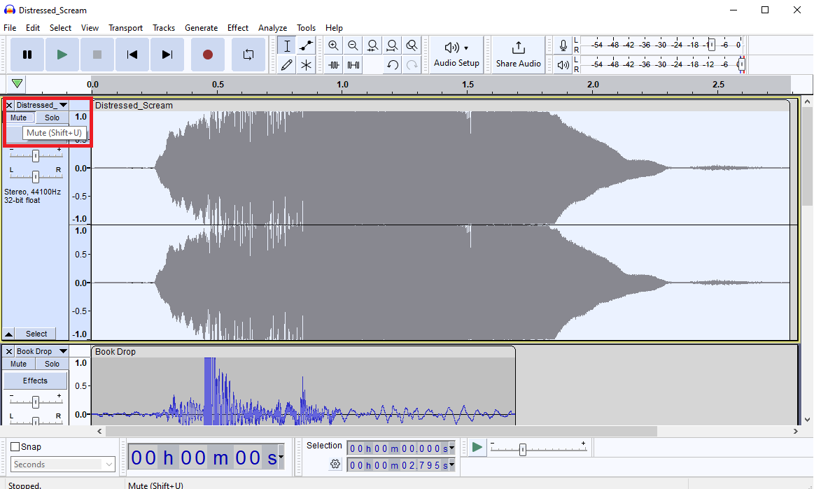
Play/Mute/Solo
At the top left of the screen, you can play/pause the sound(s)
To select certain tracks to not play, you can mute the track (press the mute button under the name of the track)
To only play a certain track, you can solo the track (press the solo button next to the mute button); this mutes every other track
Play/Pause
Mute/Solo

Slide 13
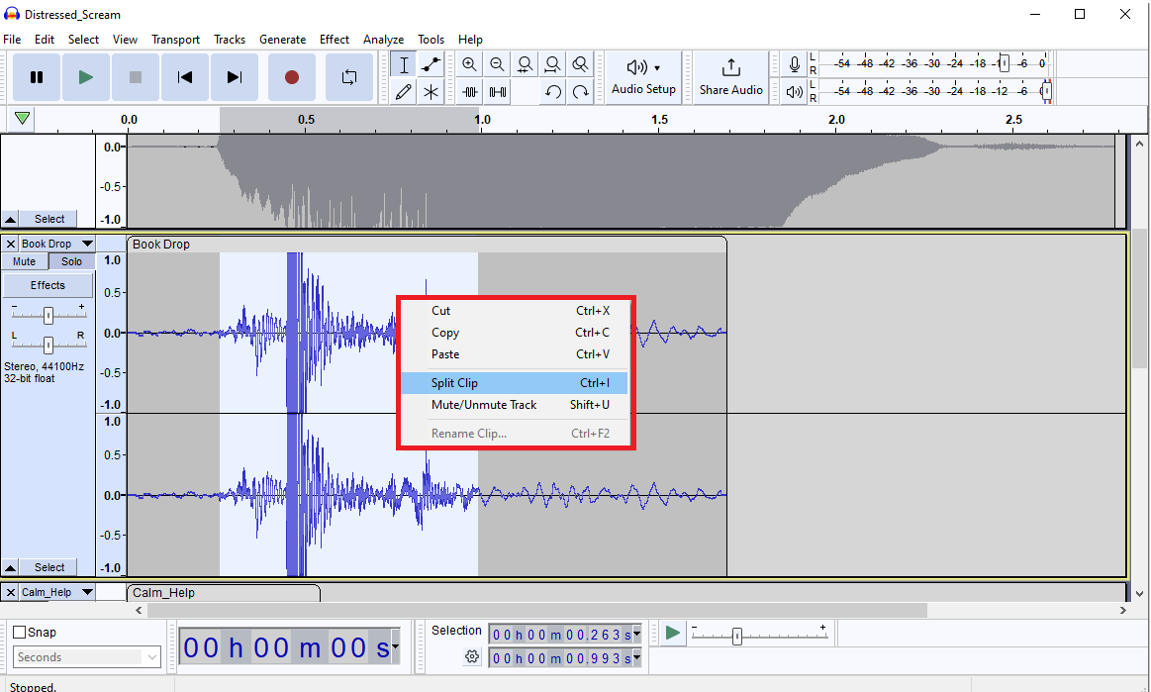
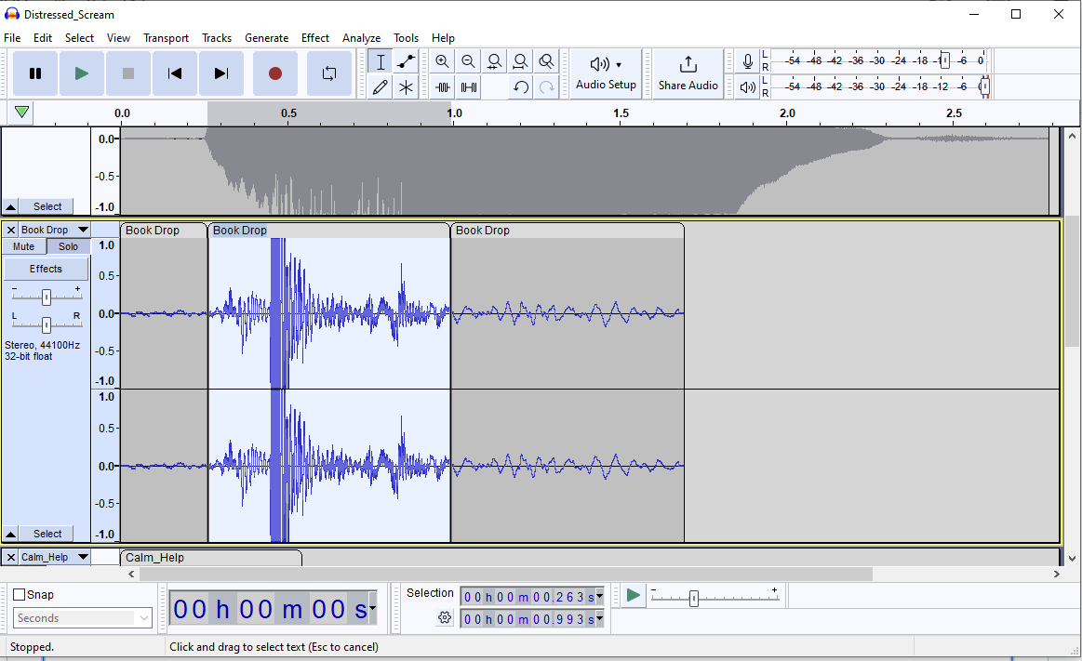
Selecting/Cutting Parts of the Audio
By left clicking and holding then releasing to either the left or the right, we can select a part of the audio (to select the whole track, click the blank part of the blueish gray box)
When selected, you can play the audio and split the audio (you can also cut/copy/paste or delete the audio (remember that you can ctrl+z to undo!))

Slide 14
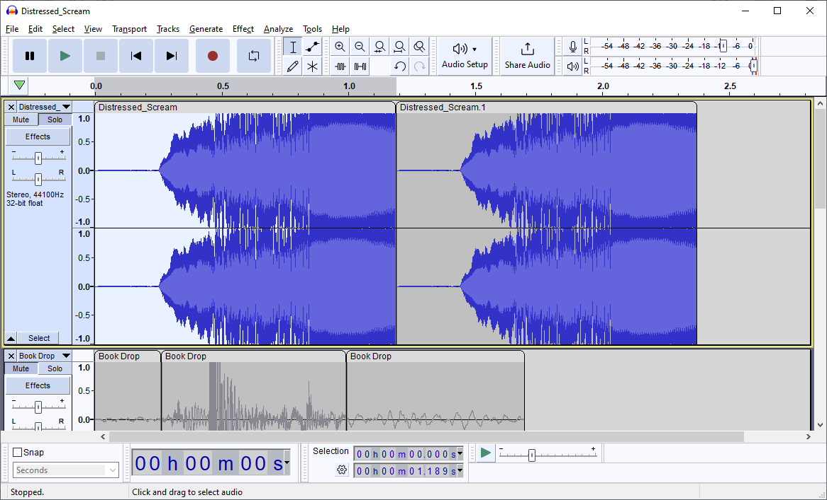

Special Effects: Reversing Sound
Solo the Distressed_Scream
Select the first half of the scream (bonus: try to get the selection to end right before the voice crack)
Split the section, then delete the second half
Then copy and paste the selection
Un-reversed
Reversed

Slide 15
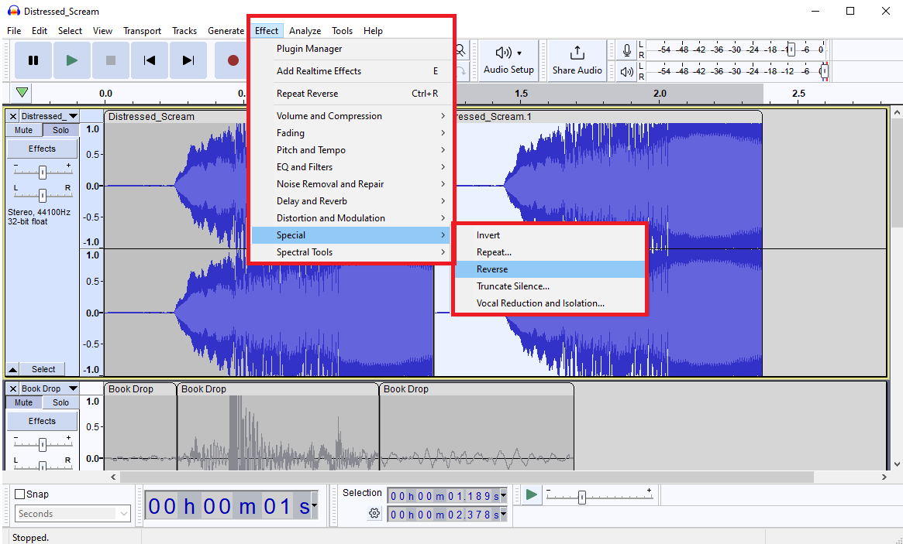
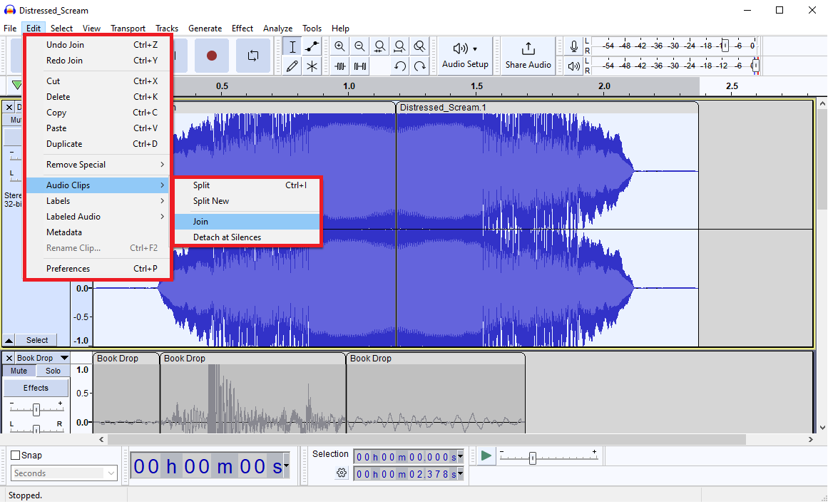
Special Effects: Reversing Sound 2
Now click on the second section of the track and go to effect, special, and select reverse
Then to join the two clips, select the whole track, then go to the edit tab, audio clips, join

Slide 16
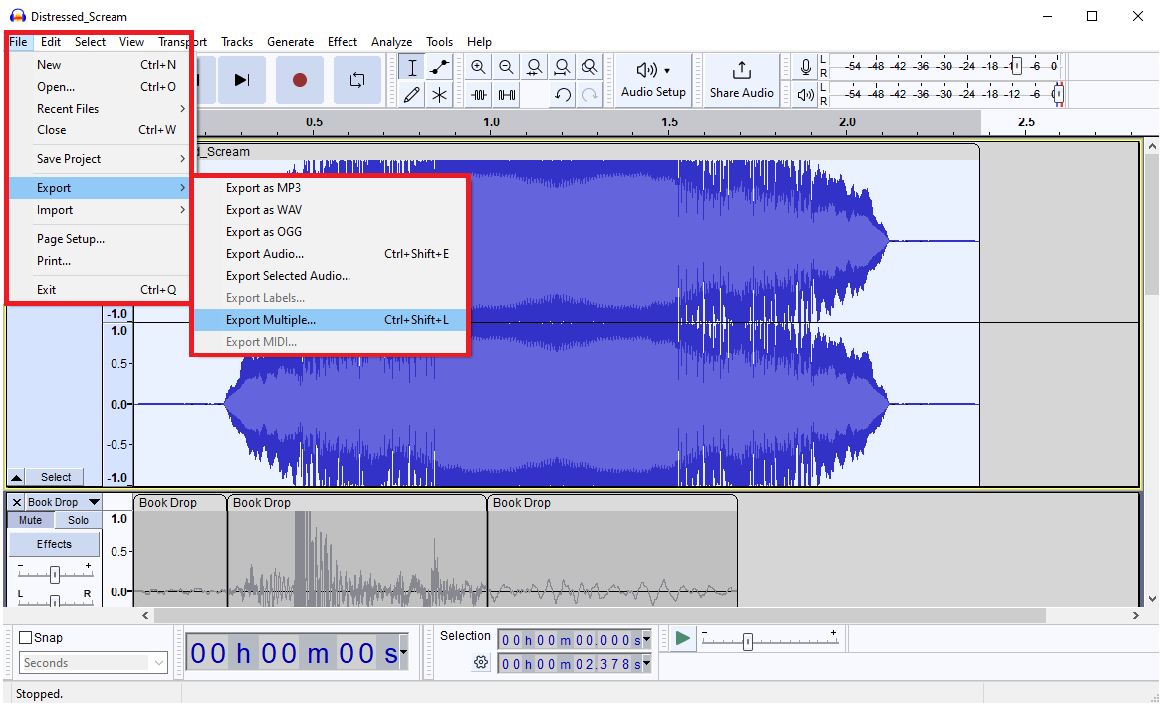
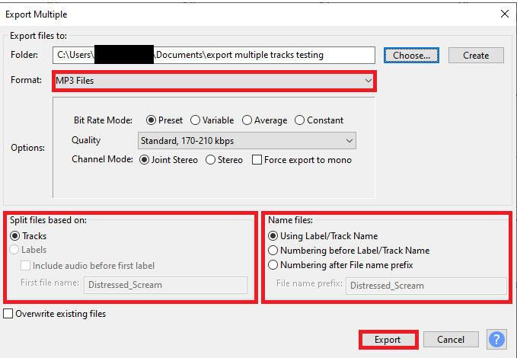
Exporting Each Track Separately
To export each track separately, make sure that all the tracks you want to export are unmuted (you can unmute all the files by soloing a track then pressing solo for that track again); then go to file, export, export multiple (note that if you export the project as .mp3, all the tracks will combine into one audio file)
Make sure to choose .mp3 as the format, tracks as the “split files on” and name files using track names

Slide 17
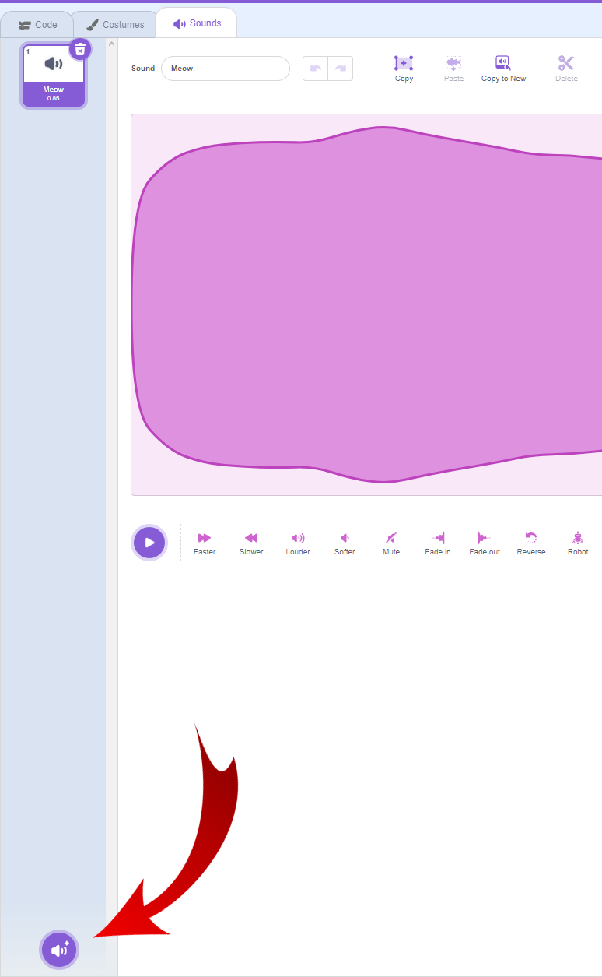
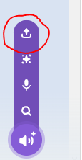
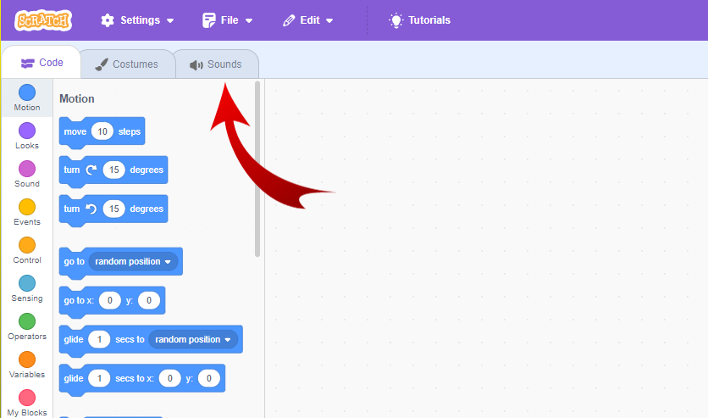
Uploading Your Sound Effect
In scratch head to sound, then at the bottom
left corner click the sound icon.
From there click the upload button (the one circled
in red) and upload your sound effect.

Slide 18
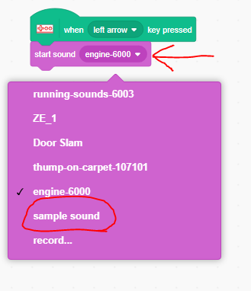
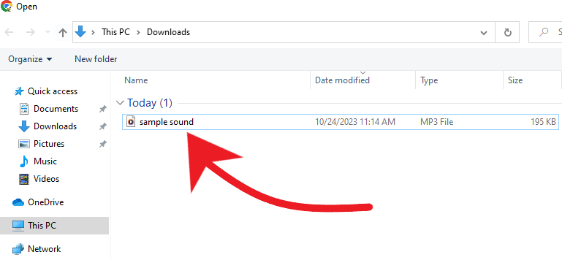
Uploading Your Sound Effect (Cont.)
Click on the sound effect file you created
You will see your sound in scratch
Go back to the code screen, and change the
Sound to your newly uploaded sound

Slide 19
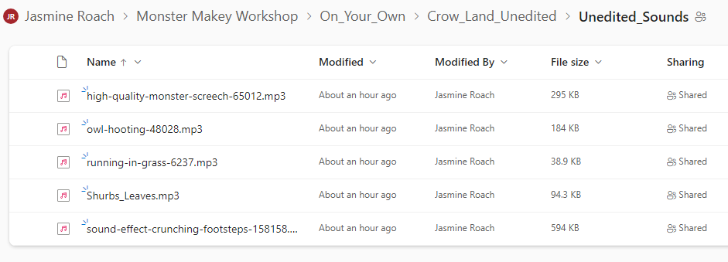
On your own
In the onedrive, there is a folder named “On_Your_Own”, there are multiple folders that have a unique story

Slide 20
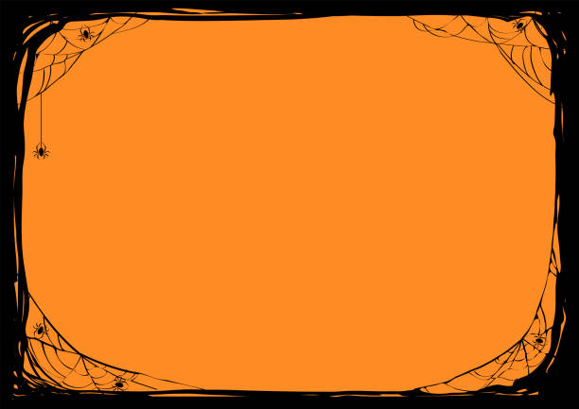
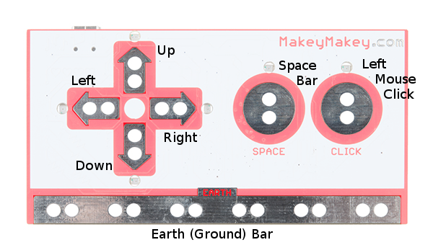
General Knowledge Recap
For the Makey Makeys to work you need to hold down the Earth function
CTRL + Z, undo changes in audacity
Audacity is a free open-source digital audio editor and recording application software
You have to hold down the Earth function to get the Makey Makey to work
TAP stands for Technical Ambassador Program
Left clicking and holding either left or right allows you you select different parts of an audio track
Clicking on the selected audio then pressing spilt audio will allow to a track to break into different sections

Slide 21
